Slide 1
MUSIC DATABASE INTERFACE
Team Lead: Touhar Fang
Frontend Dev: Steven Lee
Backend Dev: Chee Nou Lee
Database Admin: Touhar Fang

Slide 2
PROBLEM:
Unorganized Music Data.
Storing data and presenting.
Example: Title, Year Produced, Producer, ETC.
Present music to consumer front-end.
Purchasing online music.
Listening to music to in front-end.

Slide 3
SOLUTION:
Create easy solution for user to input data.
Make web-based UI that is user friendly.
Website easy for customer to navigate.
Easy to read & purchase music.

Slide 4
SPECIFICATIONS
Login page.
Purchasing music.
Playing sample.
Playing full song.
About Us page.
Contact page.

Slide 5
DATA SPECIFICATIONS:
Amount (Attributes) fields required.
Title
Artist Name
Genre
Album
Year

Slide 6
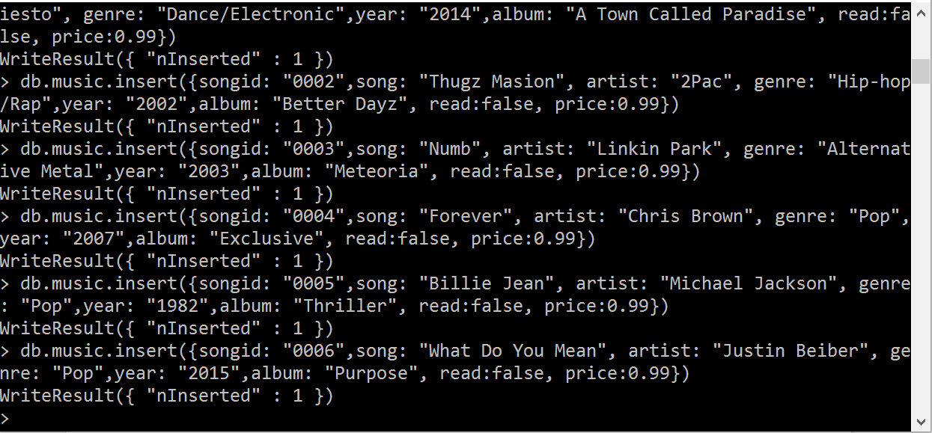
Example Backend (MongoDB):

Slide 7
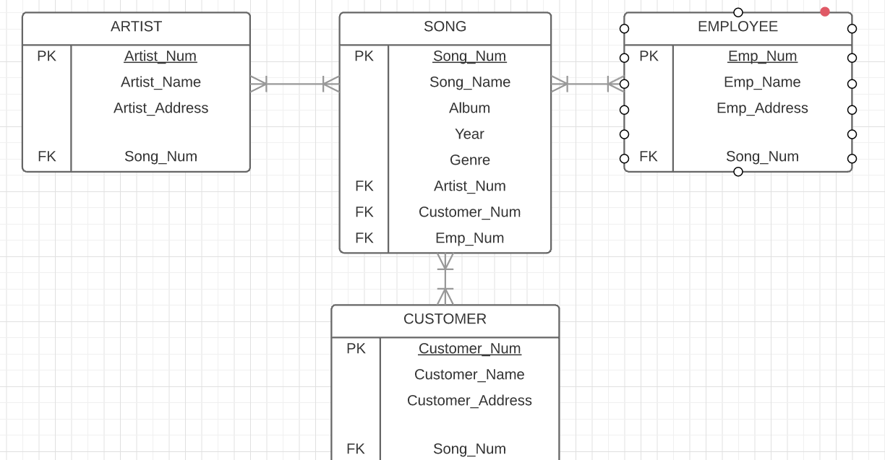
Example ERD Diagram:

Slide 8
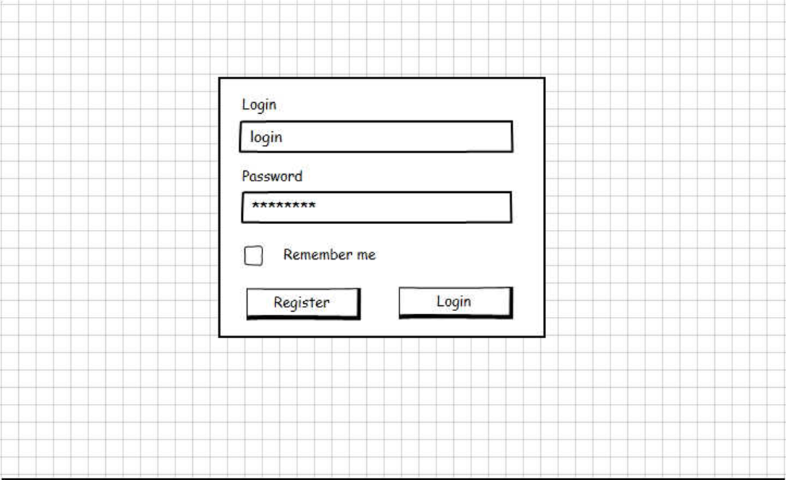
Example Wireframe:

Slide 9
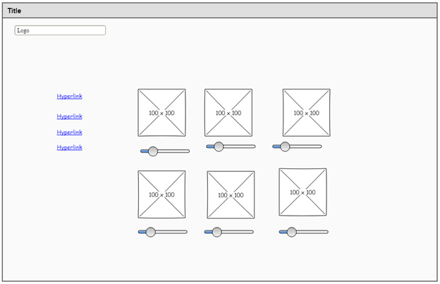
Example Wireframe:
Notes:
Add function to allow purchase. Add tables (users, music, etc)

Slide 10
LESSONS LEARNED:
Working together much harder than expected.
Reason is having the same data.
Not working on the same files or waiting for other completion.
Having time to work together.
Took longer to figure how to put everything together.
Easier to have planned in future advance.

Slide 11
QUESTIONS?

